Slide 1
ALPHABET TEST

Slide 2
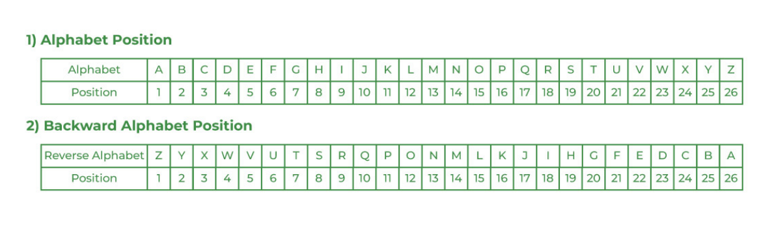
ALPHABET TEST

Slide 3
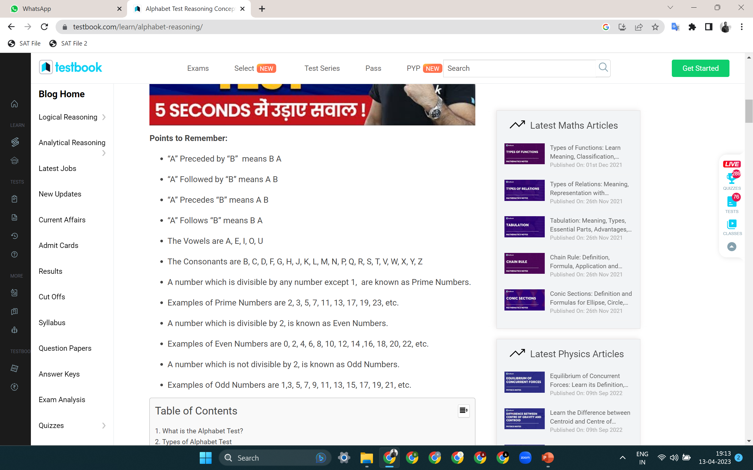

Slide 4
ALPHABET TEST
Direction: Each question is based on the following alphabet series
A B C D E F G H I J K L M N O P Q R S T U V W X Y Z
Q 1. Which letter is 5th to the left of thirteenth letter from the left end ?
(a) H (b) R (c) I (d) G (e) None of these

Slide 5
ALPHABET TEST
Direction: Each question is based on the following alphabet series
A B C D E F G H I J K L M N O P Q R S T U V W X Y Z
Q 1. Which letter is 5th to the left of thirteenth letter from the left end ?
(a) H (b) R (c) I (d) G (e) None of these

Slide 6
ALPHABET TEST
Direction: Each question is based on the following alphabet series
A B C D E F G H I J K L M N O P Q R S T U V W X Y Z
Q 2. Which letter is 6th to the right of twelfth letter from the right end ?
(a) T (b) U (c) F (d) R (e) None of these

Slide 7
ALPHABET TEST
Direction: Each question is based on the following alphabet series
A B C D E F G H I J K L M N O P Q R S T U V W X Y Z
Q 2. Which letter is 6th to the right of twelfth letter from the right end ?
(a) T (b) U (c) F (d) R (e) None of these

Slide 8
ALPHABET TEST
Direction: Each question is based on the following alphabet series
A B C D E F G H I J K L M N O P Q R S T U V W X Y Z
Q 3. Which letter is Seventh to the right of thirteenth letter from the left end ? (a) U (b) G (c) T (d) V (e) None of these

Slide 9
ALPHABET TEST
Direction: Each question is based on the following alphabet series
A B C D E F G H I J K L M N O P Q R S T U V W X Y Z
Q 3. Which letter is Seventh to the right of thirteenth letter from the left end ? (a) U (b) G (c) T (d) V (e) None of these

Slide 10
ALPHABET TEST
Direction: Each question is based on the following alphabet series
A B C D E F G H I J K L M N O P Q R S T U V W X Y Z
Q 4. Which letter is second to the left of fifth to the right to eighth to the left of twentieth letter from the left end ?
(a) O (b) P (c) Q (d) N (e) None of these

Slide 11
ALPHABET TEST
Direction: Each question is based on the following alphabet series
A B C D E F G H I J K L M N O P Q R S T U V W X Y Z
Q 4. Which letter is second to the left of fifth to the right to eighth to the left of twentieth letter from the left end ?
(a) O (b) P (c) Q (d) N (e) None of these

Slide 12
ALPHABET TEST
Direction: Each question is based on the following alphabet series
A B C D E F G H I J K L M N O P Q R S T U V W X Y Z
Q 5. Which letter is 8th to the right of seventh letter from the left ?
(a) O (b) A (c) L (d) K (e) None of these

Slide 13
ALPHABET TEST
Direction: Each question is based on the following alphabet series
A B C D E F G H I J K L M N O P Q R S T U V W X Y Z
Q 5. Which letter is 8th to the right of seventh letter from the left ?
(a) O (b) A (c) L (d) K (e) None of these

Slide 14
ALPHABET TEST
Direction: Each question is based on the following alphabet series
A B C D E F G H I J K L M N O P Q R S T U V W X Y Z
Q 6. Which letter is 4th to the left of seventh letter from the left ?
(a) W (b) X (c) C (d) D (e) None of these

Slide 15
ALPHABET TEST
Direction: Each question is based on the following alphabet series
A B C D E F G H I J K L M N O P Q R S T U V W X Y Z
Q 6. Which letter is 4th to the left of seventh letter from the left ?
(a) W (b) X (c) C (d) D (e) None of these

Slide 16
ALPHABET TEST
Direction: Each question is based on the following alphabet series
A B C D E F G H I J K L M N O P Q R S T U V W X Y Z
Q 7. Which letter is 14th to the left of 7th letter from the right ?
(a) F (b) U (c) E (d) V (e) None of these

Slide 17
ALPHABET TEST
Direction: Each question is based on the following alphabet series
A B C D E F G H I J K L M N O P Q R S T U V W X Y Z
Q 7. Which letter is 14th to the left of 7th letter from the right ?
(a) F (b) U (c) E (d) V (e) None of these

Slide 18
ALPHABET TEST
Direction: Each question is based on the following alphabet series
A B C D E F G H I J K L M N O P Q R S T U V W X Y Z
Q 8. Which letter is 10th to the right of 7th letter from the left ?
(a) Q (b) A (c) Y (d) B (e) None of these

Slide 19
ALPHABET TEST
Direction: Each question is based on the following alphabet series
A B C D E F G H I J K L M N O P Q R S T U V W X Y Z
Q 8. Which letter is 10th to the right of 7th letter from the left ?
(a) Q (b) A (c) Y (d) B (e) None of these

Slide 20
ALPHABET TEST
Direction: Reverse the following sequence of the English alphabet then answer the following questions.
A B C D E F G H I J K L M N O P Q R S T U V W X Y Z
Q 9. Which letter is 9th to the left of 24th letter from the left in new series?
(a) X (b) C (c) O (d) L (e) None of these

Slide 21
ALPHABET TEST
Direction: Reverse the following sequence of the English alphabet then answer the following questions.
A B C D E F G H I J K L M N O P Q R S T U V W X Y Z
Q 9. Which letter is 9th to the left of 24th letter from the left in new series?
(a) X (b) C (c) O (d) L (e) None of these

Slide 22
ALPHABET TEST
Direction: Reverse the following sequence of the English alphabet then answer the following questions.
A B C D E F G H I J K L M N O P Q R S T U V W X Y Z
Q 10. Which letter is 9th to the right of 24th letter from the right in new series? (a) X (b) C (c) O (d) L (e) None of these

Slide 23
ALPHABET TEST
Direction: Reverse the following sequence of the English alphabet then answer the following questions.
A B C D E F G H I J K L M N O P Q R S T U V W X Y Z
Q 10. Which letter is 9th to the right of 24th letter from the right in new series? (a) X (b) C (c) O (d) L (e) None of these

Slide 24
ALPHABET TEST
Direction: Reverse the following sequence of the English alphabet then answer the following questions.
A B C D E F G H I J K L M N O P Q R S T U V W X Y Z
Q 11. Which letter is 6th to the right of first vowel from the left end of English alphabet in new series?
(a) O (b) A (c) B (d) P (e) None of these

Slide 25
ALPHABET TEST
Direction: Reverse the following sequence of the English alphabet then answer the following questions.
A B C D E F G H I J K L M N O P Q R S T U V W X Y Z
Q 11. Which letter is 6th to the right of first vowel from the left end of English alphabet in new series?
(a) O (b) A (c) B (d) P (e) None of these

Slide 26
ALPHABET TEST
Direction: Reverse the following sequence of the English alphabet then answer the following questions.
A B C D E F G H I J K L M N O P Q R S T U V W X Y Z
Q 12. Which letter will be twelfth to the left of sixteenth letter from your left?
(a) D (b) V (c) W (d) X (e) None of these

Slide 27
ALPHABET TEST
Direction: Reverse the following sequence of the English alphabet then answer the following questions.
A B C D E F G H I J K L M N O P Q R S T U V W X Y Z
Q 12. Which letter will be twelfth to the left of sixteenth letter from your left?
(a) D (b) V (c) W (d) X (e) None of these

Slide 28
ALPHABET TEST
Direction: Reverse the following sequence of the English alphabet then answer the following questions.
A B C D E F G H I J K L M N O P Q R S T U V W X Y Z
Q 13. Which letter in sixteenth letter to the left of twenty fourth letter from the left?
(a) H (b) S (c) R (d) I (e) None of these

Slide 29
ALPHABET TEST
Direction: Reverse the following sequence of the English alphabet then answer the following questions.
A B C D E F G H I J K L M N O P Q R S T U V W X Y Z
Q 13. Which letter in sixteenth letter to the left of twenty fourth letter from the left?
(a) H (b) S (c) R (d) I (e) None of these

Slide 30
ALPHABET TEST
Direction: Each question is based on the following alphabet series:
A B C D E F G H I J K L M N O P Q R S T U V W X Y Z
Q 14. How many letter between 7th letter from left and 24th letter from left.
(a) 17 (b) 16 (c) 15 (d) 20 (e) None of these

Slide 31
ALPHABET TEST
Direction: Each question is based on the following alphabet series:
A B C D E F G H I J K L M N O P Q R S T U V W X Y Z
Q 14. How many letter between 7th letter from left and 24th letter from left.
(a) 17 (b) 16 (c) 15 (d) 20 (e) None of these

Slide 32
ALPHABET TEST
Direction: Each question is based on the following alphabet series:
A B C D E F G H I J K L M N O P Q R S T U V W X Y Z
Q 15. How many letters between 22nd letter from right and 9th letter from right end in give series.
(a) 13 (b) 14 (c) 12 (d) 11 (e) None of these

Slide 33
ALPHABET TEST
Direction: Each question is based on the following alphabet series:
A B C D E F G H I J K L M N O P Q R S T U V W X Y Z
Q 15. How many letters between 22nd letter from right and 9th letter from right end in give series.
(a) 13 (b) 14 (c) 12 (d) 11 (e) None of these

Slide 34
ALPHABET TEST
Direction: Each question is based on the following alphabet series:
A B C D E F G H I J K L M N O P Q R S T U V W X Y Z
Q 16. How many letters are in midway between 5th letter from the left and 4th letter from the right ?
(a) 15 (b) 16 (c) 17 (d) 18 (e) None of these

Slide 35
ALPHABET TEST
Direction: Each question is based on the following alphabet series:
A B C D E F G H I J K L M N O P Q R S T U V W X Y Z
Q 16. How many letters are in midway between 5th letter from the left and 4th letter from the right ?
(a) 15 (b) 16 (c) 17 (d) 18 (e) None of these

Slide 36
ALPHABET TEST
Direction: Each question is based on the following alphabet series:
A B C D E F G H I J K L M N O P Q R S T U V W X Y Z
Q 17. How many letters between 18th letter from left and 10th letters from right. (a) 7 (b) 14 (c) 0 (d) 8 (e) None of these

Slide 37
ALPHABET TEST
Direction: Each question is based on the following alphabet series:
A B C D E F G H I J K L M N O P Q R S T U V W X Y Z
Q 17. How many letters between 18th letter from left and 10th letters from right. (a) 7 (b) 14 (c) 0 (d) 8 (e) None of these

Slide 38
ALPHABET TEST
Direction: Each question is based on the following alphabet series:
A B C D E F G H I J K L M N O P Q R S T U V W X Y Z
Q 18. How many letters between 22nd letter to the left and 23rd letter from right end.
(a) 0 (b) 17 (c) 15 (d) 1 (e) None of these

Slide 39
ALPHABET TEST
Direction: Each question is based on the following alphabet series:
A B C D E F G H I J K L M N O P Q R S T U V W X Y Z
Q 18. How many letters between 22nd letter to the left and 23rd letter from right end.
(a) 0 (b) 17 (c) 15 (d) 1 (e) None of these

Slide 40
ALPHABET TEST
Direction: Each question is based on the following alphabet series:
A B C D E F G H I J K L M N O P Q R S T U V W X Y Z
Q 19. How many letters between 2nd and last vowel of given alphabet.
(a) 16 (b) 15 (c) 14 (d) 17 (e) None of these

Slide 41
ALPHABET TEST
Direction: Each question is based on the following alphabet series:
A B C D E F G H I J K L M N O P Q R S T U V W X Y Z
Q 19. How many letters between 2nd and last vowel of given alphabet.
(a) 16 (b) 15 (c) 14 (d) 17 (e) None of these

Slide 42
ALPHABET TEST
Direction: Each question is based on the following alphabet series:
A B C D E F G H I J K L M N O P Q R S T U V W X Y Z
Q 20. How many letters between 22nd letter to the left and 3rd vowel from beginning in English alphabet.
(a) 13 (b) 14 (c) 15 (d) 11 (e) None of these

Slide 43
ALPHABET TEST
Direction: Each question is based on the following alphabet series:
A B C D E F G H I J K L M N O P Q R S T U V W X Y Z
Q 20. How many letters between 22nd letter to the left and 3rd vowel from beginning in English alphabet.
(a) 13 (b) 14 (c) 15 (d) 11 (e) None of these

Slide 44
ALPHABET TEST
Direction: Each question is based on the following alphabet series:
A B C D E F G H I J K L M N O P Q R S T U V W X Y Z
Q 21. Which letter is between midway of 13th letter from the left and 4th letter from the right ?
(a) R (b) I (c) J (d) S (e) None of these

Slide 45
ALPHABET TEST
Direction: Each question is based on the following alphabet series:
A B C D E F G H I J K L M N O P Q R S T U V W X Y Z
Q 21. Which letter is between midway of 13th letter from the left and 4th letter from the right ?
(a) R (b) I (c) J (d) S (e) None of these

Slide 46
ALPHABET TEST
Direction: Each question is based on the following alphabet series:
A B C D E F G H I J K L M N O P Q R S T U V W X Y Z
Q 22. Which letter is exactly between the 7th letter from the left and 23th letter from left end.
(a) O (b) P (c) N (d) L (e) None of these

Slide 47
ALPHABET TEST
Direction: Each question is based on the following alphabet series:
A B C D E F G H I J K L M N O P Q R S T U V W X Y Z
Q 22. Which letter is exactly between the 7th letter from the left and 23th letter from left end.
(a) O (b) P (c) N (d) L (e) None of these

Slide 48
ALPHABET TEST
Direction: Each question is based on the following alphabet series:
A B C D E F G H I J K L M N O P Q R S T U V W X Y Z
Q 23. Which letter/s is/are exactly between the 7th letter from the left and 20th letter from left end.
(a) M, N (b) M (c) N (d) N, P (e) None of these

Slide 49
ALPHABET TEST
Direction: Each question is based on the following alphabet series:
A B C D E F G H I J K L M N O P Q R S T U V W X Y Z
Q 23. Which letter/s is/are exactly between the 7th letter from the left and 20th letter from left end.
(a) M, N (b) M (c) N (d) N, P (e) None of these

Slide 50
ALPHABET TEST
Direction: Each question is based on the following alphabet series:
A B C D E F G H I J K L M N O P Q R S T U V W X Y Z
Q 24. Which letter is exactly between the 6th letter from the left and 18th letter from left end.
(a) L (b) N (c) O (d) P (e) None of these

Slide 51
ALPHABET TEST
Direction: Each question is based on the following alphabet series:
A B C D E F G H I J K L M N O P Q R S T U V W X Y Z
Q 24. Which letter is exactly between the 6th letter from the left and 18th letter from left end.
(a) L (b) N (c) O (d) P (e) None of these

Slide 52
ALPHABET TEST
Direction: Each question is based on the following alphabet series:
A B C D E F G H I J K L M N O P Q R S T U V W X Y Z
Q 25. If the letters from T to Z are interchanged by the letters A to G in such a way that A takes the position of T and so on, then which will be the third letter to the left of 18th letter from the right ?
(a) Y (b) U (c) C (d) S (e) None of these

Slide 53
ALPHABET TEST
Direction: Each question is based on the following alphabet series:
A B C D E F G H I J K L M N O P Q R S T U V W X Y Z
Q 25. If the letters from T to Z are interchanged by the letters A to G in such a way that A takes the position of T and so on, then which will be the third letter to the left of 18th letter from the right ?
(a) Y (b) U (c) C (d) S (e) None of these

Slide 54
ALPHABET TEST
Direction: Each question is based on the following alphabet series:
A B C D E F G H I J K L M N O P Q R S T U V W X Y Z
Q 26. If the first 5 letters are written in reversed order, then the next five letters are written in reversed order and so on, which is 7th letter to the right of 9th letter from the left ?
(a) T (b) S (c) P (d) Q (e) None of these

Slide 55
ALPHABET TEST
Direction: Each question is based on the following alphabet series:
A B C D E F G H I J K L M N O P Q R S T U V W X Y Z
Q 26. If the first 5 letters are written in reversed order, then the next five letters are written in reversed order and so on, which is 7th letter to the right of 9th letter from the left ?
(a) T (b) S (c) P (d) Q (e) None of these

Slide 56
ALPHABET TEST
Direction: Each question is based on the following alphabet series:
A B C D E F G H I J K L M N O P Q R S T U V W X Y Z
Q 27. If the first 6 letters are written in reversed order, then the next 5 letters are written in reversed order and again next 6 letters are written in reversed order then which letter is midway between 7th letter from the left and 12th letter from the right?
(a) G (b) T (c) H (d) U (e) None of these

Slide 57
ALPHABET TEST
Direction: Each question is based on the following alphabet series:
A B C D E F G H I J K L M N O P Q R S T U V W X Y Z
Q 27. If the first 6 letters are written in reversed order, then the next 5 letters are written in reversed order and again next 6 letters are written in reversed order then which letter is midway between 7th letter from the left and 12th letter from the right?
(a) G (b) T (c) H (d) U (e) None of these

Slide 58
ALPHABET TEST
Direction: Each question is based on the following alphabet series:
A B C D E F G H I J K L M N O P Q R S T U V W X Y Z
Q 28. If the first 5 letters are fixed next 12 letter written in reversed order and remaining letters are also fixed. Then how many letters are at the same place when its written in alphabetical order.
(a) 5 (b) 7 (c) 6 (d) 8 (e) None of these

Slide 59
ALPHABET TEST
Direction: Each question is based on the following alphabet series:
A B C D E F G H I J K L M N O P Q R S T U V W X Y Z
Q 28. If the first 5 letters are fixed next 12 letter written in reversed order and remaining letters are also fixed. Then how many letters are at the same place when its written in alphabetical order.
(a) 5 (b) 7 (c) 6 (d) 8 (e) None of these

Slide 60
ALPHABET TEST
Direction: Each question is based on the following alphabet series:
A B C D E F G H I J K L M N O P Q R S T U V W X Y Z
Q 29. If the first ten letters of the given alphabet are written in the reversed oder. Which of the following letters will be the seventh to the left of the twelfth letter from the right end.
(a) B (b) I (c) H (d) C (e) None of these

Slide 61
ALPHABET TEST
Direction: Each question is based on the following alphabet series:
A B C D E F G H I J K L M N O P Q R S T U V W X Y Z
Q 29. If the first ten letters of the given alphabet are written in the reversed oder. Which of the following letters will be the seventh to the left of the twelfth letter from the right end.
(a) B (b) I (c) H (d) C (e) None of these

Slide 62
ALPHABET TEST
Direction: Each question is based on the following alphabet series:
A B C D E F G H I J K L M N O P Q R S T U V W X Y Z
Q 30. If every alternate letter, starting with A, is removed from the alphabet, which letter among the remaining letters would be the third to the right of the fifth letter from the right?
(a) X (b) V (c) L (d) J (e) None of these

Slide 63
ALPHABET TEST
Direction: Each question is based on the following alphabet series:
A B C D E F G H I J K L M N O P Q R S T U V W X Y Z
Q 30. If every alternate letter, starting with A, is removed from the alphabet, which letter among the remaining letters would be the third to the right of the fifth letter from the right?
(a) X (b) V (c) L (d) J (e) None of these

Slide 64
THANK YOU

